Slide 1
Lab 14

Slide 2
Lab 13: Center points
Add 2-4 center points
Check for lack of fit
H0: Higher order terms needed

Slide 3
Introduction
Continuation of lab 12 and 13
Addition: steepest ascent
JMP for model building, stepwise, CCD
Excel for data handling, steepest ascent
OBJECTIVES:
Use the method of steepest ascent to find new center values to be used in optimization
Optimize your significant terms by using steepest ascent along with DOE methods you already know
Analyze your model using central composite designs in JMP

Slide 4
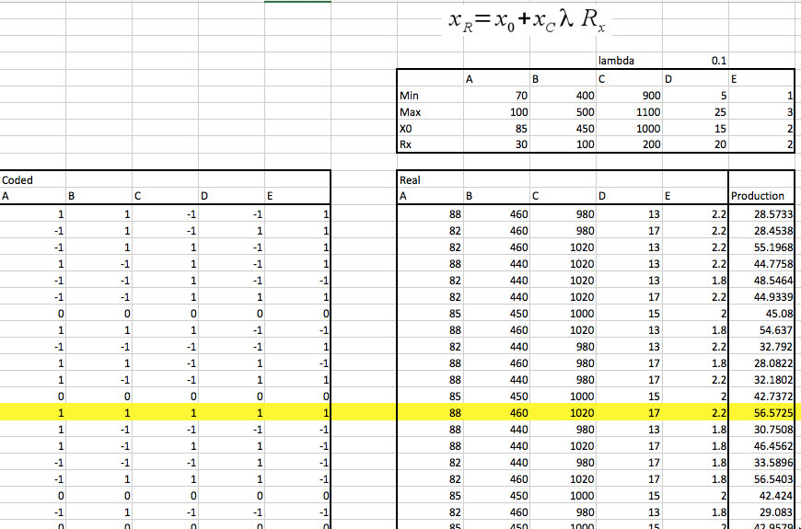
Step 1
Create a fractional factorial design with 5 factors, 4 center points
Can use data created for lab 13 if you have saved it
Translate coded values into real values
Keep lambda as 0.1

Slide 5
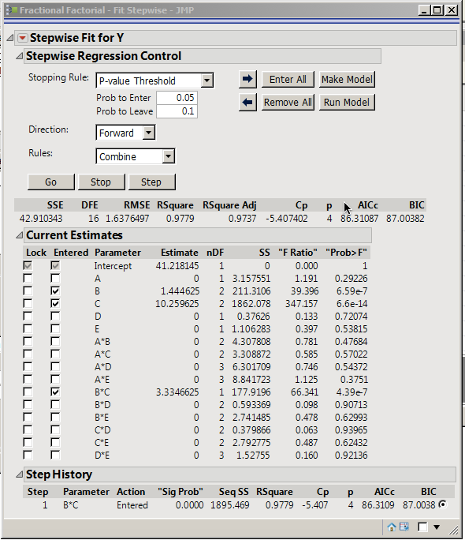
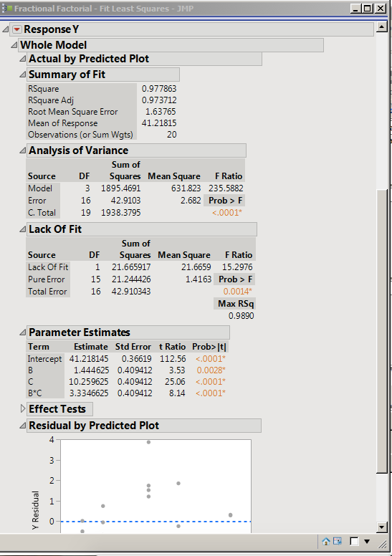
Step 2
Perform stepwise regression
B, C and B*C will be significant
Make model

Slide 6
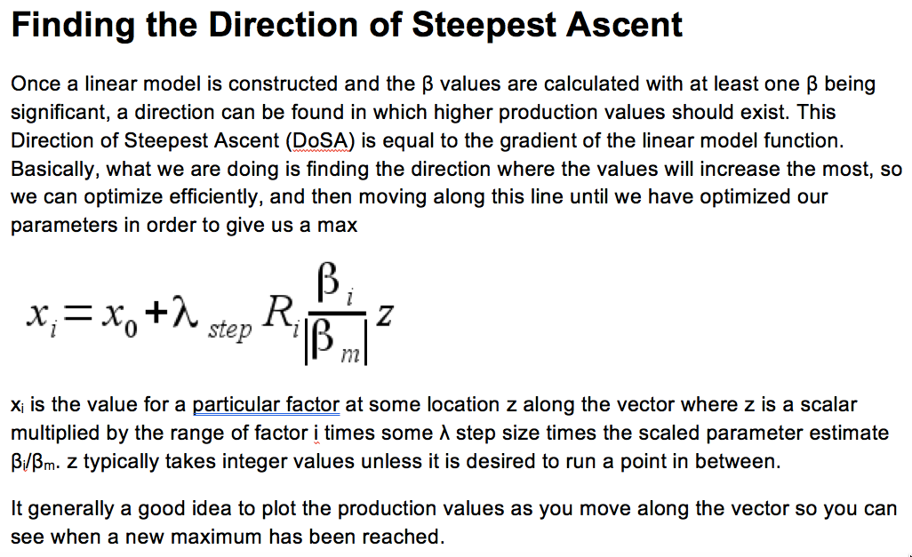

Step 3: Perform steepest ascent
Taking norm of $β_{i}$ will be a better idea than using $β_{m}$

Slide 7
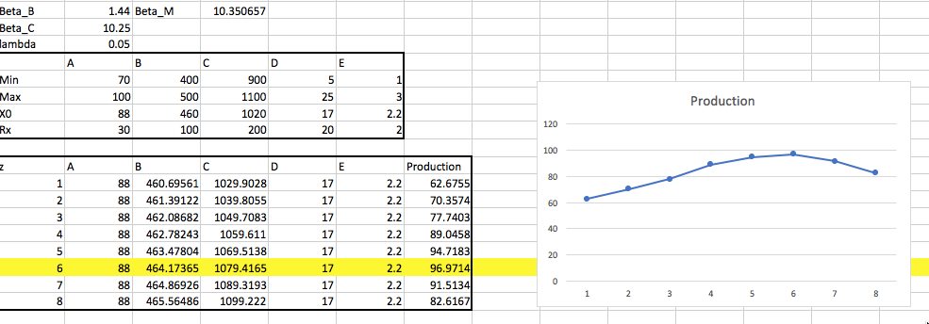
Step 3: Perform steepest ascent
Keep insignificant factors to the value which gave maximum production
Perform steepest ascent for B and C. Keep lambda as 0.05 now.

Slide 8
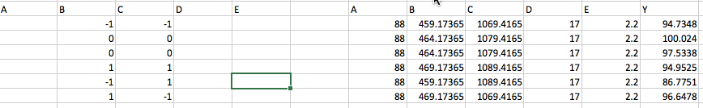
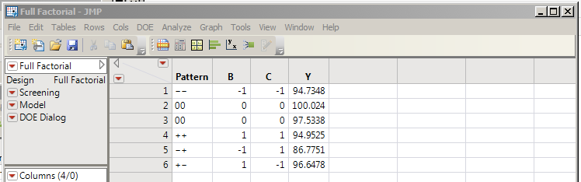
Step 4
Change x0 to value that gave maximum production in steepest ascent
Make model with significant factors (B and C) and check for significance again

Slide 9
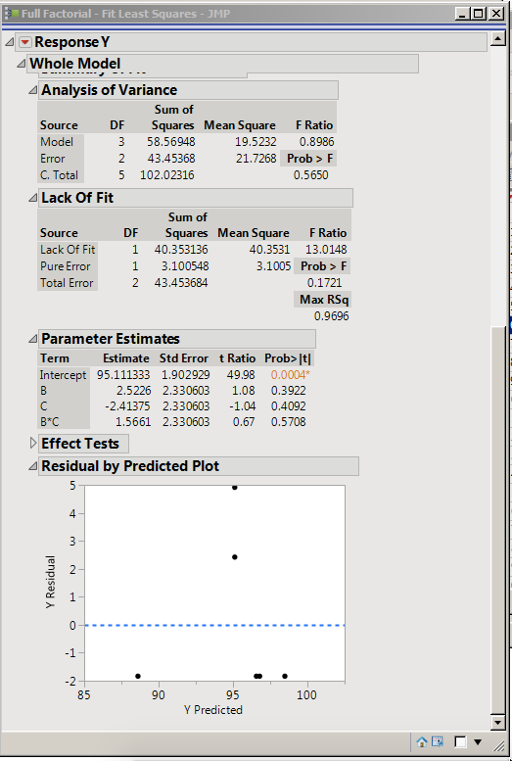
Step 4
Upon making model, B and C do not remain significant
Hence, done with steepest ascent
If any factor is still significant, perform steepest ascent on that factor again

Slide 10
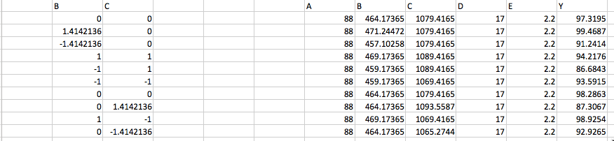
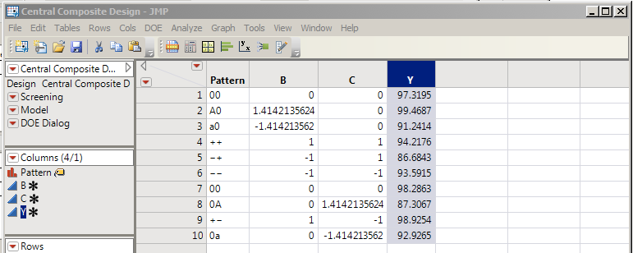
Step 5: Perform CCD
DOE -> Response Surface Design
“Central Composite Design” with 2 center points
“Rotatable” in axial value
Analyze -> Fit model

Slide 11
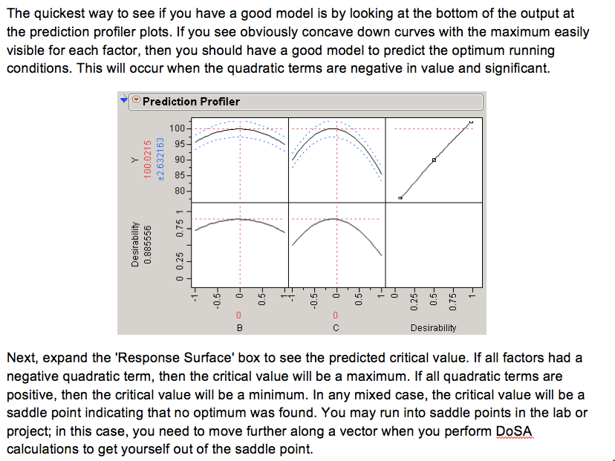
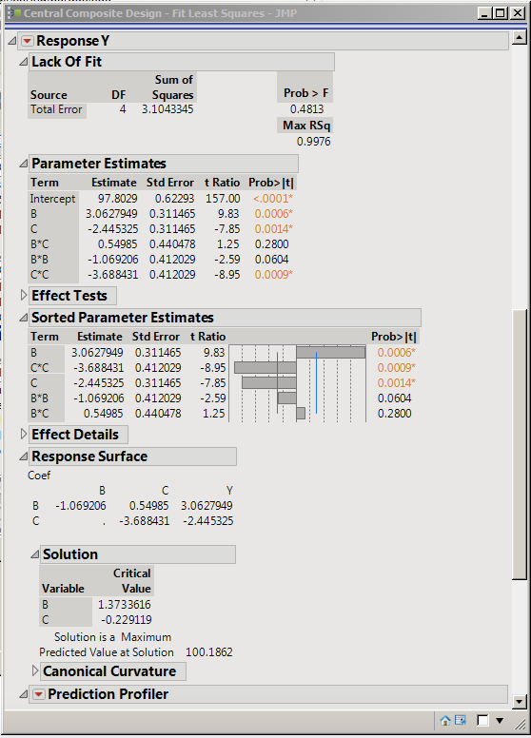
Step 5: Perform CCD

Slide 12
Step 6: Use the values to get optimal production
Use critical values of significant factors (from CCD analysis)
Convert to real values (using step length formula)
Find production at these real values

Slide 13
Total runs
Initial data building: 20
Steepest ascent: 8
Model building post steepest ascent: 6
CCD: 10
Total: 44
Try to finish everything within 50 runs

Slide 14
Lab 14: Conclusion
DOE with 5 factors with 4 center points, find point with maximum production. [JMP]
Perform stepwise to find significant factors. Make model [JMP]
Shift x0 to point with maximum production. Perform steepest ascent on significant factors. [Excel]
Change x0 to one with maximum production. Made model and check for significance again. [JMP]
Perform CCD [JMP]
Use critical values to find optimal production [Excel]
Calculate total runs [Excel]

